Slide 1
Suggested Analyses of WRAP Drilling Rig Databases
Doug Blewitt, CCM

Slide 2
Database Overview
The WRAP NO2 and NOx databases represent very detailed experimental programs that can be used to evaluate a non-reactive pollutant (e.g. NOx) and reactive NO2
A complete evaluation of measurements is needed before model evaluations are conducted
A database analysis will require a detailed plan, coordination and discussion among participants and stakeholders
Analysis will require time and funding!

Slide 3
DJ
Overview of Database in CO
Two data campaigns were performed at two drilling sites
Measurement of NOx and NO2 concentrations (emissions) and stack parameters from a Tier 2 drilling rig
Measurement of air quality and meteorological parameters
  NO2/NOx concentrations at 12 monitors
  Upwind and downwind ozone
  Meteorological data
Data have undergone a quality assurance evaluation and deemed accurate and valid
Data have not been analyzed in terms of correlating impacts with emissions and meteorology

Slide 4
DJ
Task recommendations needed prior to model evaluation (data review)
Need to calculate mass emission rate for all sources
  Need to convert concentration to mass emission rate
  Verification is needed to ensure data are available for calculations
Calculate actual exit velocity based on stack delta pressure and other associated measurements
Need to calculate the distance between the well being drilled and the downwind monitors and monitor elevation
  Computations needed to evaluate distance and azimuth for each sampler

Slide 5
DJ Data
Analysis of ambient and source data
Ambient data needs to be reviewed to evaluate trends in ambient concentrations under different emission rates and meteorological conditions
  Evaluate wind direction alignment from source to monitors to known azimuth
  Identify potential influence from mobile source emissions
  Review ambient ozone data and evaluate ozone scavenging

Slide 6
DJ Data
Analysis of NOx Ambient
Review all the ambient monitoring data in
relation to emission data and meteorological
data
  Review all hours of monitoring data to evaluate if impacts occurred at specific monitors
  The ambient data should be separated into three categories:
    No monitored impacts from rig (background);
    Periods when plume centerline and plume half width were identified; and
    Periods of source impact but plume centerline was not observed

Slide 7
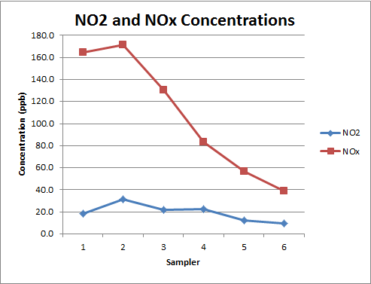
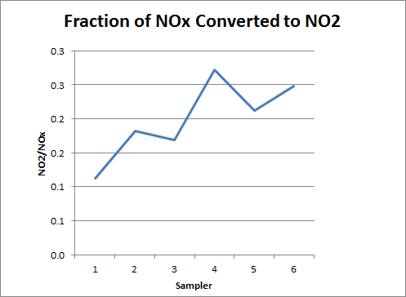
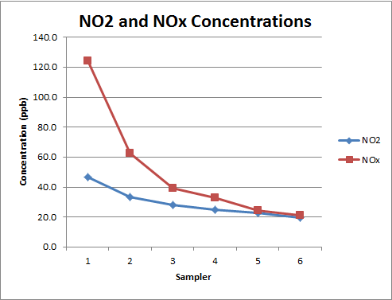
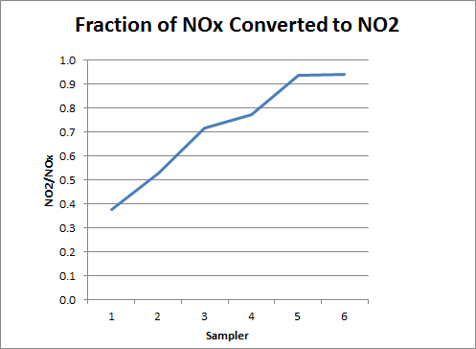
DJ Data
Analysis of NOx Ambient (continued)
Parsing of Ambient Data
Centerline Observed
No Centerline Observed – useful data for model evaluation

Slide 8
DJ Data
Analysis of NOx Ambient (continued)
For periods when impacts were measured, it will be important to examine the impacts to evaluate if they are a result of the drill rig engines or a result of construction equipment that was operational at the site
  This will involve detailed evaluation of meteorological conditions and examination of the 5-minute data and NO2/NOx ratios
Compile basic statistics on frequency of impacts/vs. no impacts and overall monitoring coverage
Time series and crosswind concentration plots should be developed. Care should be given to accurately presenting the crosswind data for well site 1 when the monitors were arranged in an “L” configuration and the monitors were not equal distance from the drill rig

Slide 9
DJ Data
Analysis of O3 Ambient (continued)
Cross validate onsite ozone data with nearby AQS monitors and evaluate historical AQS monitors to develop plan for ozone data substitution for missing ozone
It is important that only rural ozone monitors be used in this evaluation

Slide 10
DJ Data
Impact Analysis and Building a Modelers Database
Perform analysis of ambient data impacts
  Perform comparisons of upwind and downwind data to determine degree of ambient impacts
  Evaluate plume characteristics during impact events based on meteorological conditions (e.g., plume width, variation in NO2/NOx ratio across plume width, crosswind integrated concentrations)
  Characterize NO/NO₂ speciation based on emissions, meteorological and background data
  Construct a modeling database that identifies data to be used for model evaluation
    Use a format similar to what EPA has used for previous modeling archive databases
    The database should contain emission measurements, meteorological measurements and ambient measurements in a single file (Excel) so that inter comparison of the data can be made
  Results of this analysis need to be summarized in a data analysis report

Slide 11
DJ
Additional Data Needed for Model Input
Need to agree on the approach for the conversion of ppb to ug/m³ actual or standard
Need to calculate downwash parameters for BPIP.
Previous modeling conducted for rigs has indicated that BPIP PRIME did not accurately estimate the ambient turbulence generated by the rig. This may or may not be an issue for the DJ rig
Determine surface roughness using multiple approaches
  Typical surface roughness for DJ land use type
  Surface roughness based on the physical structure height
  Potentially evaluate surface roughness by wind direction
Obtain upper air data and process met data through AERMET

Slide 12
Overview of Database in AK
Monitor is located at the edge of drill pad
Drill rig located at well sites ~1 month per well
Rig operated 1 week per well on diesel fuel remaining weeks on line power
Therefore 1 week of drill rig impacts
3 weeks of background and mobile source impacts
Distance between source and monitor changed as new wells were drilled

Slide 13
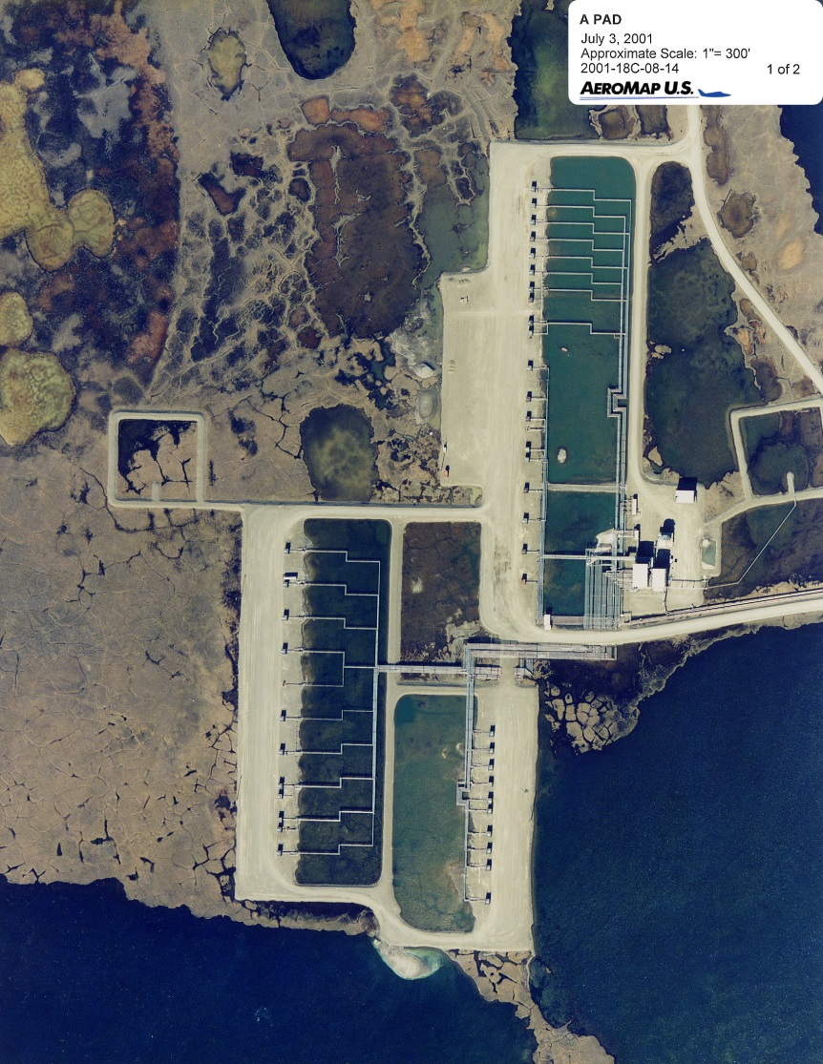
Typical Drill Pad and Ambient Monitoring Site in AK
Wells
Monitor
Not pad used in WRAP study but similar

Slide 14
AK
Recommendations for Analysis of Drill Rig Data
Task recommendations needed prior to model evaluation (data review)
Need to calculate mass emission rate for all sources
  Method 19 should be used
  Verification is needed to ensure data are available for necessary calculations
  Calculate actual exit velocity based on stack diameter and Method 19 volume flow calculations
Need to calculate the distance between the well being drilled and the downwind monitor
  The distance between source and monitor changed for each well that was drilled
  Google Earth is not accurate in this region

Slide 15
AK
Analysis of Ambient and Source Data
Need to correlate emission data with the ambient data and determine a subset of ambient measurements when the drill rigs were being powered by diesel as opposed to line power
Ambient data when the rigs were on diesel needs to be further reviewed to evaluate trends in ambient concentrations under different emission rates and meteorological conditions
  Evaluate wind direction alignment to actual source azimuth
  Evaluate NO₂/NOx ratio based on what portion of the plume impacts the monitor. This may not be clear cut because of additional entrainment from structures
  Evaluate the change in distance as the drill rig moved and the distance between the rig and the monitor changed
  Identify potential influence from mobile source emissions
  Review ambient ozone data and evaluate ozone scavenging
  Identify periods of ambient and source data that can be used for model evaluation

Slide 16
AK
Analysis of Ambient and Source Data (continued)
The ambient data when the rigs were on line power will be useful in determining the influence of mobile sources
Examine peak concentrations when using line power
Examine NO2/NOx ratios. There may be a possible change in the NO2/NOx ratio for mobile sources compared to the diesel engines

Slide 17
AK
Additional Data Needed for Model Input
Need to agree on the approach for the conversion of ppb to ug/m³ actual or standard
Need to calculate downwash parameters for BPIP. Previous modeling conducted for the rig indicated that BPIP PRIME did not accurately estimate the ambient turbulence generated by the rig
Determine surface roughness using multiple approaches
  Tundra
  Surface roughness based on the physical structure height
  Potentially evaluate surface roughness by wind direction
Obtain upper air data and process met data through AERMET

Slide 18
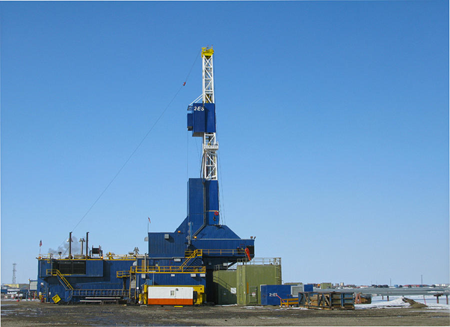
AK
Drilling Rig
Previous analysis indicated that enhanced turbulence from rig structure
was needed to describe nearfield concentrations

Slide 19
WRAP Database Deliverables
Results of the analysis of monitoring data need to be summarized in a report
Construct a modeling database that identifies data to be used for model evaluation
Database should contain emission measurements, meteorological measurements and ambient measurements in a single file

Slide 20
DJ and AK
Model Evaluation
Agree on model evaluation approach. Possible model data comparisons:
Evaluate monitor predictions to monitoring data pairing approaches
  Event basis – paired in time and space
  NOx
  NO2
  NO2/NOx ratio
Develop modeling protocol
Perform model evaluation
Report results

Slide 21
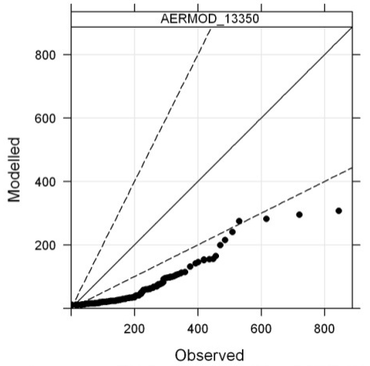
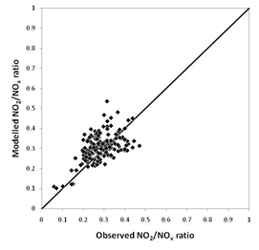
Pairing of Data for Model Evaluation
NOx unpaired in time
Under prediction a result of downwash issues
Predicted and observed NO2/NOx ADMS
Evaluates conversion independent of NOx
Wainwright
Prudhoe Bay
NO2 using NOx pairing
NO2 independent of time
Empire Abo
Empire Abo

Slide 22
Conclusions
DJ and AK are very rich databases that have information to evaluate both non-reactive and NO₂ pollutants
Monitored impacts are strongly influenced by downwash and data may result in a better understanding of impacts close to complex structures
Databases require complete analyses to build a modeling database and this will require time and funding

